Slide 1
Model Free Prediction

Slide 2
Outline
Introduction
Monte Carlo Learning
Temporal Difference Learning

Slide 3


Recap: Planning by dynamic programming
In our gridworld example, we taught our agent how to reach the objective (terminal state)

Slide 4
Recap: Planning by dynamic programming
This is a classic reinforcement learning problem and we can formalize this environment by using a Markov Decision Process (MDP).

Slide 5
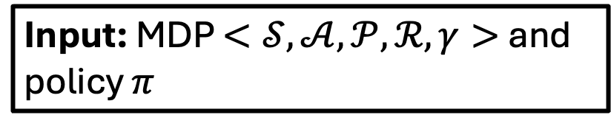
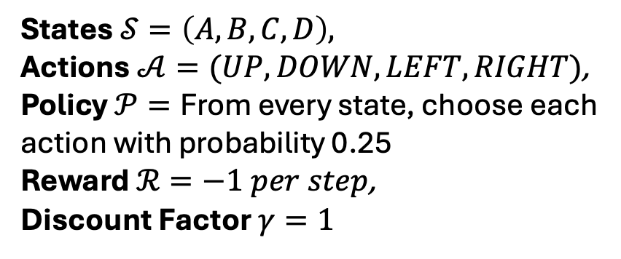
Recap: Planning by dynamic programming
Input: MDP $<𝒮, 𝒜,𝒫,ℛ,γ>$and policy $π$
States $𝒮=\left(A,B,C,D\right),$
Actions $𝒜=(UP, DOWN, LEFT, RIGHT)$,
Policy $𝒫=\text{From} \text{every} \text{state}\text{, }\text{choose} \text{each} \text{action} \text{with} \text{probability}\text{ 0.25}$
Reward $ℛ=−1 per step$,
Discount Factor $γ=1$
This is how we formalize the gridworld problem as a Markov decision Process

Slide 6
Recap: Planning by dynamic programming
Input: MDP $<𝒮, 𝒜,𝒫,ℛ,γ>$and policy $π$
States $𝒮=\left(A,B,C,D\right),$
Actions $𝒜=(UP, DOWN, LEFT, RIGHT)$,
Policy $𝒫=\text{From} \text{every} \text{state}\text{, }\text{choose} \text{each} \text{action} \text{with} \text{probability}\text{ 0.25}$
Reward $ℛ=−1 per step$,
Discount Factor $γ=1$
When we solve an MDP problem, our primary goal is to find the best behaviour (optimal policy)…

Slide 7
Recap: Planning by dynamic programming
Input: MDP $<𝒮, 𝒜,𝒫,ℛ,γ>$and policy $π$
States $𝒮=\left(A,B,C,D\right),$
Actions $𝒜=(UP, DOWN, LEFT, RIGHT)$,
Policy $𝒫=\text{From} \text{every} \text{state}\text{, }\text{choose} \text{each} \text{action} \text{with} \text{probability}\text{ 0.25}$
Reward $ℛ=−1 per step$,
Discount Factor $γ=1$
… that maximizes the amount of reward to that the agent can expect to get from any state $𝒮$

Slide 8
Recap: Planning by dynamic programming
A | B
C | D
Input: MDP $<𝒮, 𝒜,𝒫,ℛ,γ>$and policy $π$
States $𝒮=\left(A,B,C,D\right),$
Actions $𝒜=(UP, DOWN, LEFT, RIGHT)$,
Policy $𝒫=\text{From} \text{every} \text{state}\text{, }\text{choose} \text{each} \text{action} \text{with} \text{probability}\text{ 0.25}$
Reward $ℛ=−1 per step$,
Discount Factor $γ=1$

Slide 9
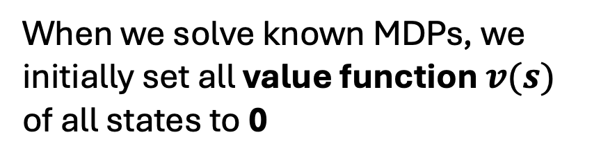
Recap: Planning by dynamic programming
0 | 0
0 | 0
When we solve known MDPs, we initially set all value function $v(s)$ of all states to 0

Slide 10
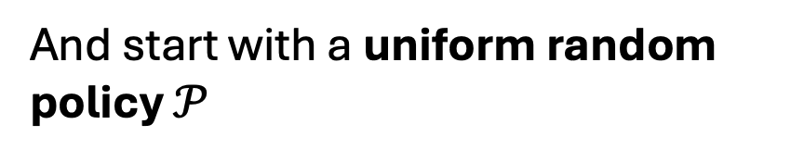
Recap: Planning by dynamic programming
And start with a uniform random policy $𝒫$

Slide 11
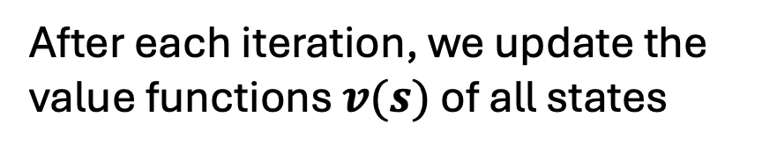
Recap: Planning by dynamic programming
-1 | -1
-1 | 0
After each iteration, we update the value functions $v(s)$ of all states

Slide 12

Recap: Planning by dynamic programming
And get a new policy $π$

Slide 13
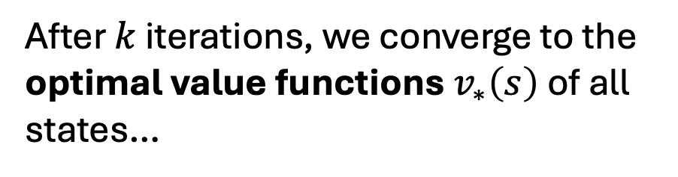
Recap: Planning by dynamic programming
-2 | -1.75
-1.75 | 0
After $k$ iterations, we converge to the optimal value functions $v_{∗}\left(s\right)$ of all states…

Slide 14
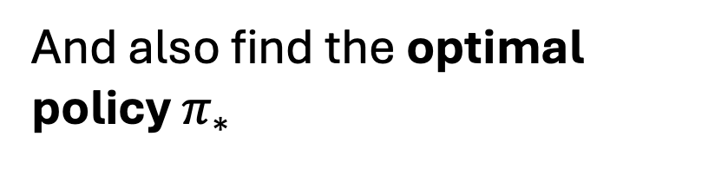
Recap: Planning by dynamic programming
And also find the optimal policy $π_{∗}$

Slide 15
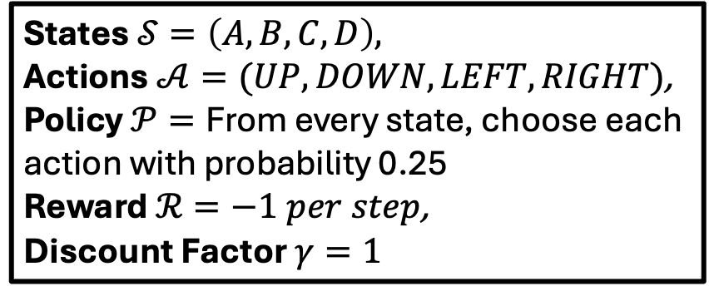
Model Free Reinforcement Learning
Input: MDP $<𝒮, 𝒜,𝒫,ℛ,γ>$and policy $π$
States $𝒮=\left(A,B,C,D\right),$
Actions $𝒜=(UP, DOWN, LEFT, RIGHT)$,
Policy $𝒫=\text{From} \text{every} \text{state}\text{, }\text{choose} \text{each} \text{action} \text{with} \text{probability}\text{ 0.25}$
Reward $ℛ=−1 per step$,
Discount Factor $γ=1$
The gridworld problem is a prime example of a known MDP

Slide 16
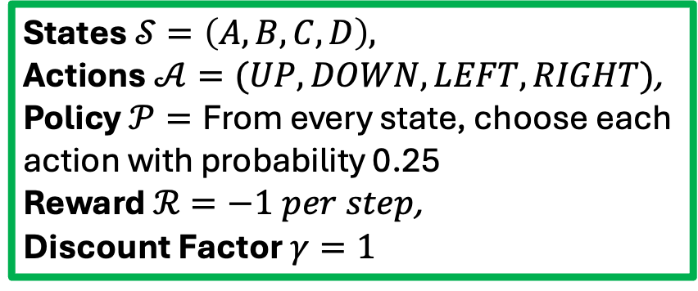
Model Free Reinforcement Learning
Input: MDP $<𝒮, 𝒜,𝒫,ℛ,γ>$and policy $π$
States $𝒮=\left(A,B,C,D\right),$
Actions $𝒜=(UP, DOWN, LEFT, RIGHT)$,
Policy $𝒫=\text{From} \text{every} \text{state}\text{, }\text{choose} \text{each} \text{action} \text{with} \text{probability}\text{ 0.25}$
Reward $ℛ=−1 per step$,
Discount Factor $γ=1$
A known MDP is where someone already told you the dynamics of the environment and its reward functions.

Slide 17
Model Free Reinforcement Learning
Input: MDP $<𝒮, 𝒜,𝒫,ℛ,γ>$and policy $π$
States $𝒮=\left(A,B,C,D\right),$
Actions $𝒜=(UP, DOWN, LEFT, RIGHT)$,
Policy $𝒫=\text{From} \text{every} \text{state}\text{, }\text{choose} \text{each} \text{action} \text{with} \text{probability}\text{ 0.25}$
Reward $ℛ=−1 per step$,
Discount Factor $γ=1$
By knowning dynamics of the environment and its reward functions…

Slide 18
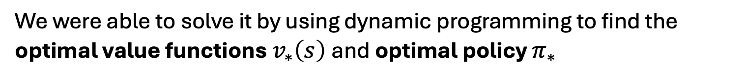
Model Free Reinforcement Learning
-2 | -1.75
-1.75 | 0
We were able to solve it by using dynamic programming to find the optimal value functions $v_{∗}\left(s\right)$and optimal policy $π_{∗}$

Slide 19
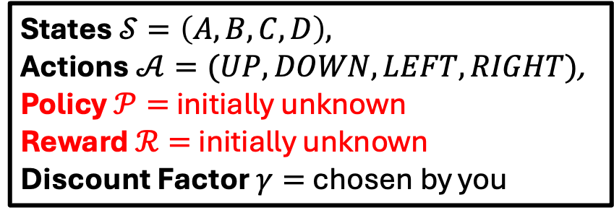
Model Free Reinforcement Learning
Input: MDP $<𝒮, 𝒜,𝒫,ℛ,γ>$and policy $π$
States $𝒮=\left(A,B,C,D\right),$
Actions $𝒜=(UP, DOWN, LEFT, RIGHT)$,
Policy $𝒫=$ initially unknown
Reward $ℛ=$ initially unknown
Discount Factor $γ=$ chosen by you
But what happens if the MDP is unknown?

Slide 20
Model Free Reinforcement Learning
Input: MDP $<𝒮, 𝒜,𝒫,ℛ,γ>$and policy $π$
States $𝒮=\left(A,B,C,D\right),$
Actions $𝒜=(UP, DOWN, LEFT, RIGHT)$,
Policy $𝒫=$ initially unknown
Reward $ℛ=$ initially unknown
Discount Factor $γ=$ chosen by you
In model free reinforcement learning, the MDP is unknown.

Slide 21
Model Free Reinforcement Learning
Input: MDP $<𝒮, 𝒜,𝒫,ℛ,γ>$and policy $π$
States $𝒮=\left(A,B,C,D\right),$
Actions $𝒜=(UP, DOWN, LEFT, RIGHT)$,
Policy $𝒫=$ initially unknown
Reward $ℛ=$ initially unknown
Discount Factor $γ=$ chosen by you
In other words, in an unknown MDP, no one tells you how the world or the environment works.

Slide 22
Model Free Reinforcement Learning
The MDP is unknown.
The agent directly learns from experience.
Trial and Error.

Slide 23
Model Free Reinforcement Learning
In model-free RL, all the agent can do is play, watch what happens, and learn from experience.

Slide 24
Model Free Reinforcement Learning
Over time, the agent figures out which actions tend to lead to more rewards…

Slide 25
Model Free Reinforcement Learning
and it adjusts how to play, thus learning the best strategy (optimal policy $π_{∗}$).

Slide 26
Model Free Reinforcement Learning
The idea is that given the experience and the received reward, the agent will update its value function or policy.

Slide 27
Model Free Reinforcement Learning
Monte Carlo and Temporal Difference Learning are two different strategies on how to update our value function or our policy.

Slide 28
Model Free Reinforcement Learning
Both of them use experience to solve the unknown MDP problem.

Slide 29
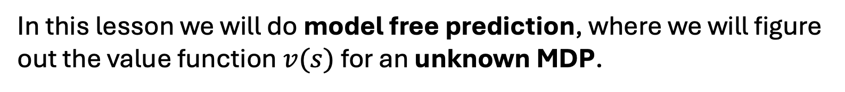
Model Free Reinforcement Learning
In this lesson we will do model free prediction, where we will figure out the value function $v(s)$ for an unknown MDP.

Slide 30
Outline
Introduction
Monte Carlo Learning
Temporal Difference Learning

Slide 31
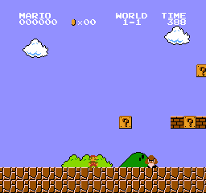
Types of Tasks in RL
In Episodic tasks, we have a starting point and an ending point (a terminal state).
For example, think about Super Mario Bros, an episode begins at the launch of a new Mario Level and ends when you’re killed or you reached the end of the level.

Slide 32
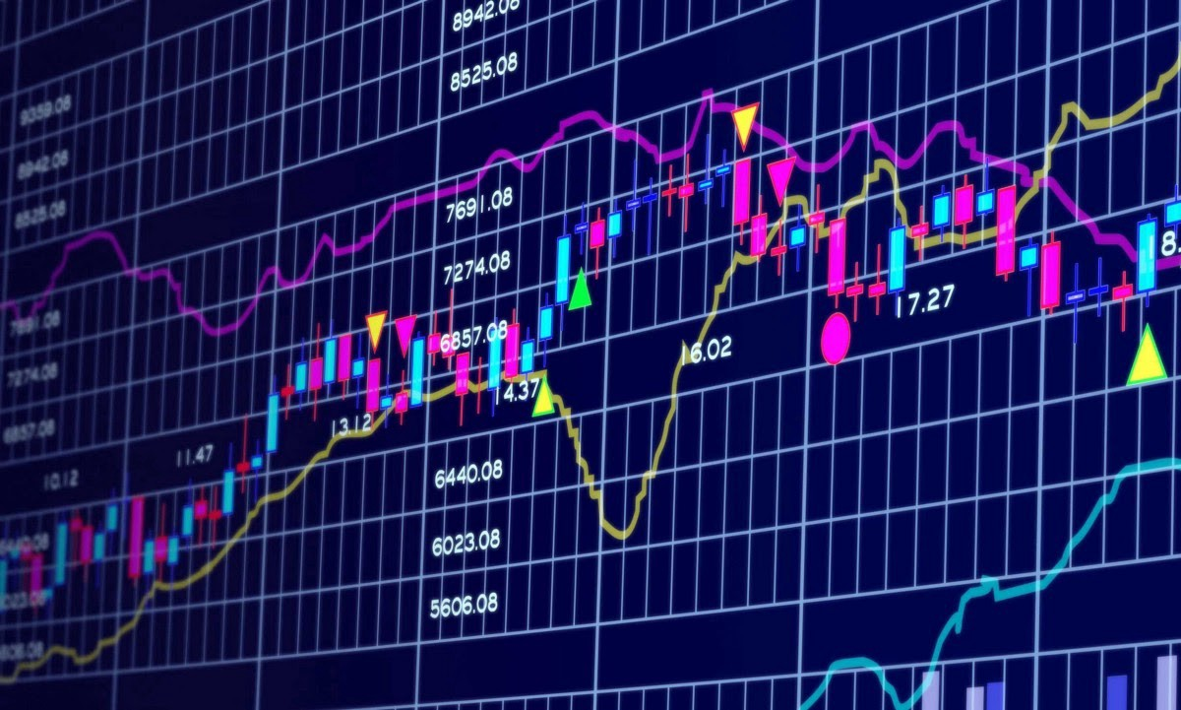
Types of Tasks in RL
In Continuing tasks, tasks that continue forever (no terminal state).
In this case, the agent must learn how to choose the best actions and simultaneously interact with the environment.

Slide 33
Types of Tasks in RL
For example, an agent that does automated stock trading.
For this task, there is no starting point and terminal state. The agent keeps running until we decide to stop it.

Slide 34
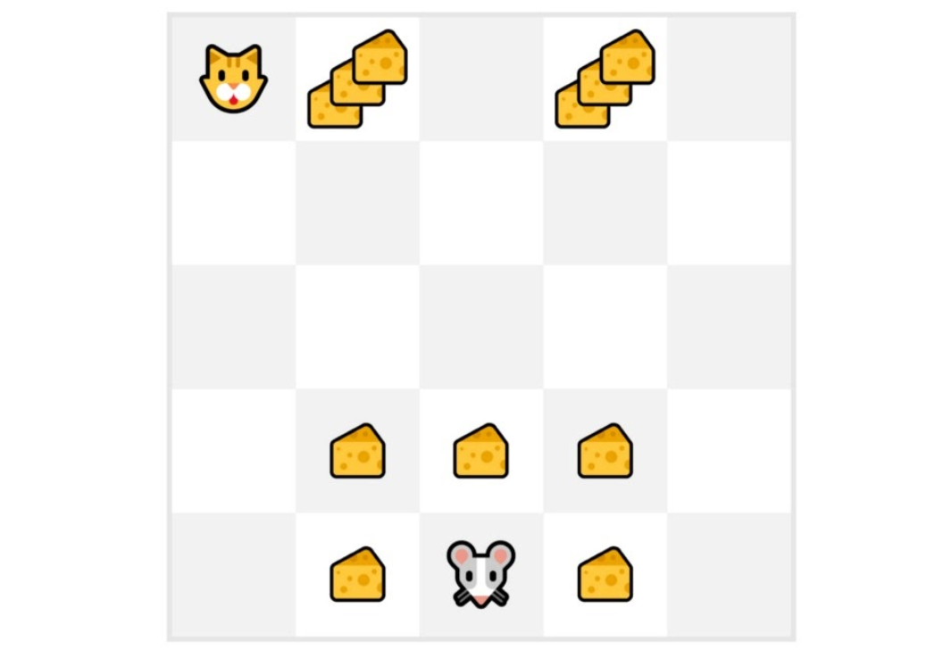
Monte-Carlo Reinforcement Learning
Let’s say your agent is this tiny mouse that can move one tile each time step, and your opponent is the cat.
The mouse’s goal is to eat the maximum amount of cheese before being eaten by the cat.

Slide 35
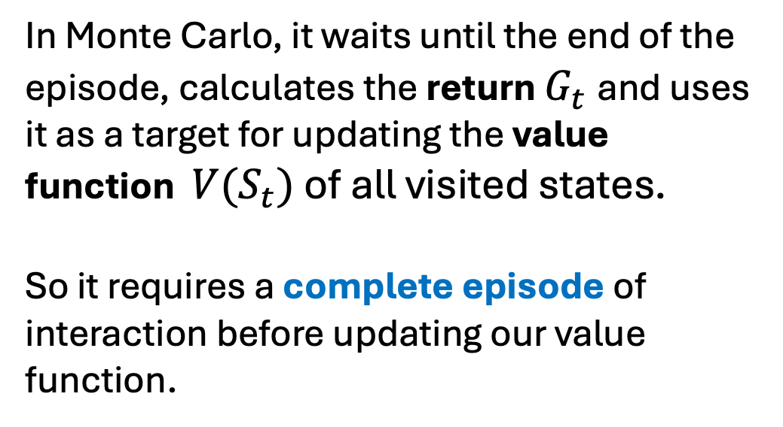
Monte-Carlo Reinforcement Learning
In Monte Carlo, it waits until the end of the episode, calculates the return $G_{t}$and uses it as a target for updating the value function $V(S_{t})$ of all visited states.
So it requires a complete episode of interaction before updating our value function.

Slide 36
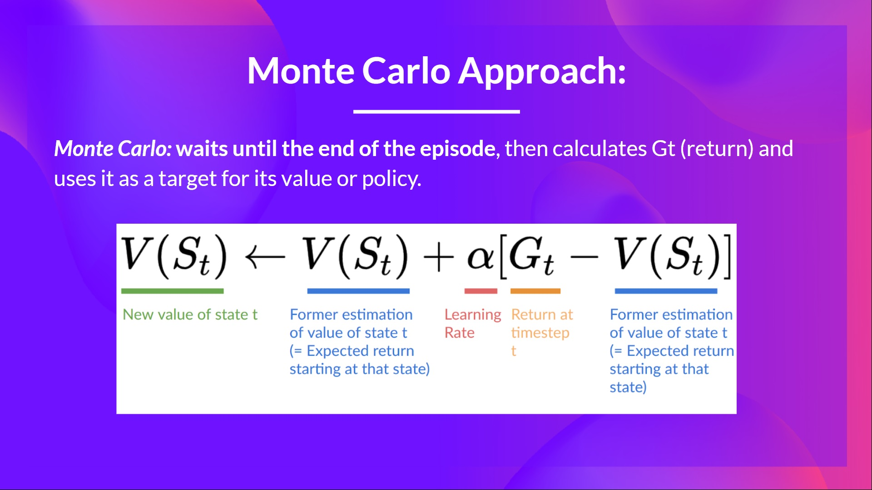

Slide 37
Monte-Carlo Reinforcement Learning
For each episode, we always start at the same starting point.
The agent takes actions using a random policy.
We terminate the episode if the cat eats the mouse or if the mouse moves more than 10 steps.

Slide 38
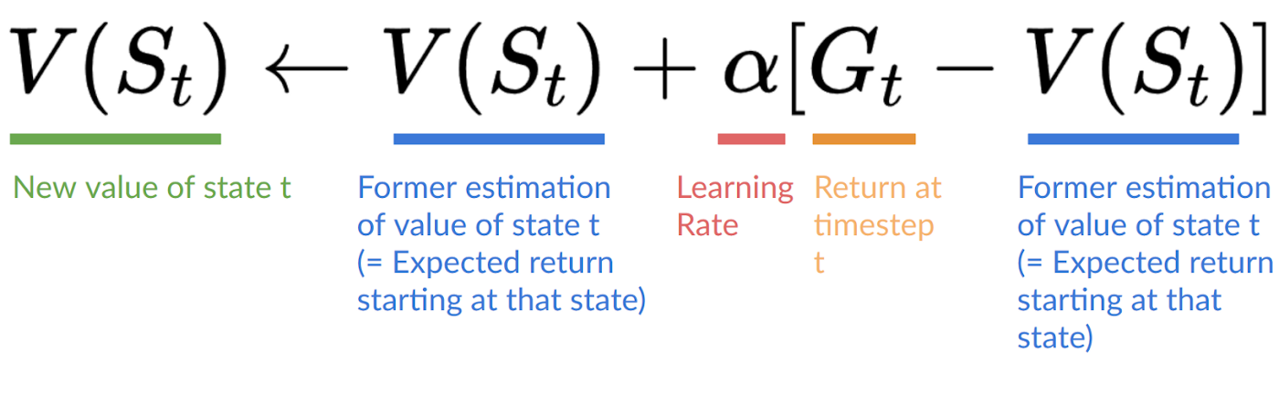
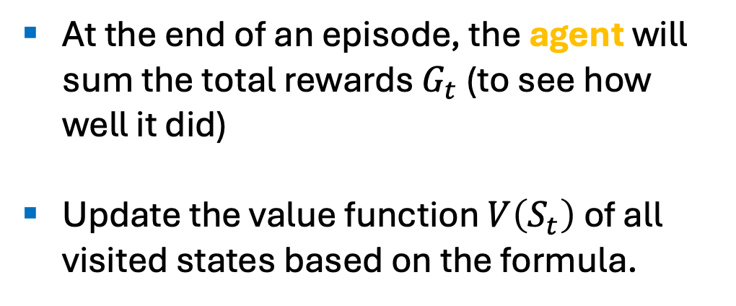
Monte-Carlo Reinforcement Learning
At the end of an episode, the agent will sum the total rewards $G_{t}$ (to see how well it did)
Update the value function $V\left(S_{t}\right)$ of all visited states based on the formula.

Slide 39
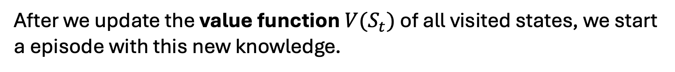
Monte-Carlo Reinforcement Learning
After we update the value function $V(S_{t})$ of all visited states, we start a episode with this new knowledge.

Slide 40
Monte-Carlo Reinforcement Learning
By running more and more episodes, the agent will learn to play better and better.

Slide 41
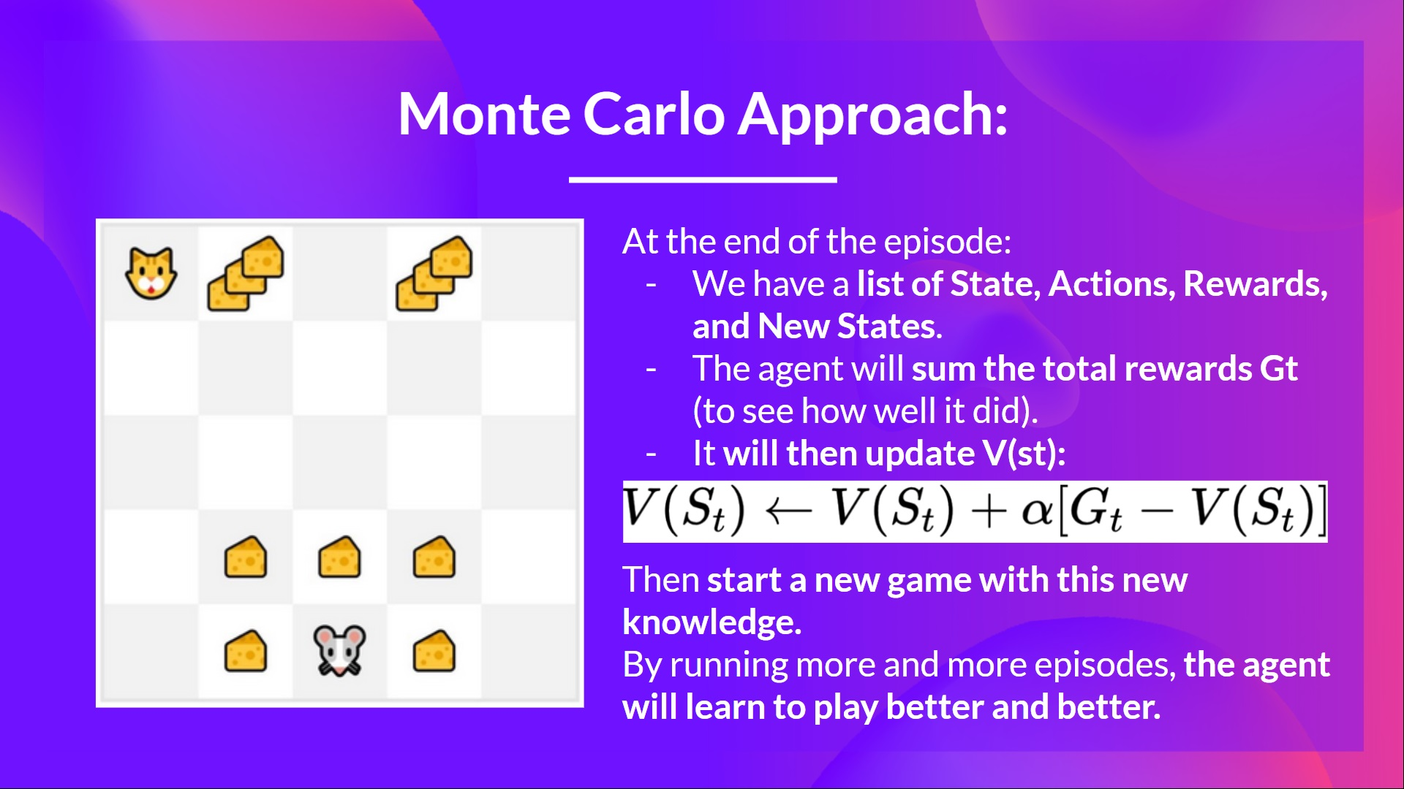

Slide 42
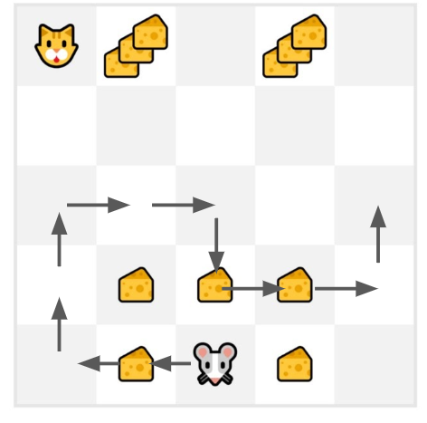
Monte-Carlo Reinforcement Learning
Let us use Monte-Carlo in Action!
First, let us initialize our value function of all states to 0.
Then let us set our learning rate to 0.1 and our discount rate to 1.
And our mouse explores the environment and takes random actions.

Slide 43
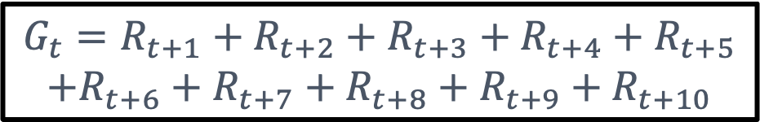

Monte-Carlo Reinforcement Learning
We calculate the return for this episode
$$G_{t}=R_{t+1}​+R_{t+2}​​+R_{t+3}+R_{t+4}+R_{t+5}$$
$$+R_{t+6}+R_{t+7}+R_{t+8}+R_{t+9}+R_{t+10}​​​​​​​$$
$$G_{0}=0+1+0+0+0+0+1+1+0+0$$
$$G_{0}=3$$

Slide 44
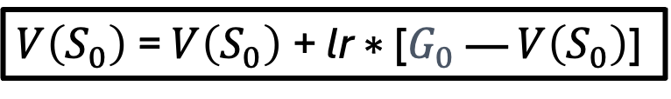


Monte-Carlo Reinforcement Learning
And we compute the new value functions of all states that were visited in the episode.
$V\left(S_{0}\right)$= $V\left(S_{0}\right)$+ lr ∗ [$G_{0}$​— $V\left(S_{0}\right)$]
$$V\left(S_{0}\right)=0+0.1 × [ 3−0]$$
$$V\left(S_{0}\right)=0.3$$

Slide 45
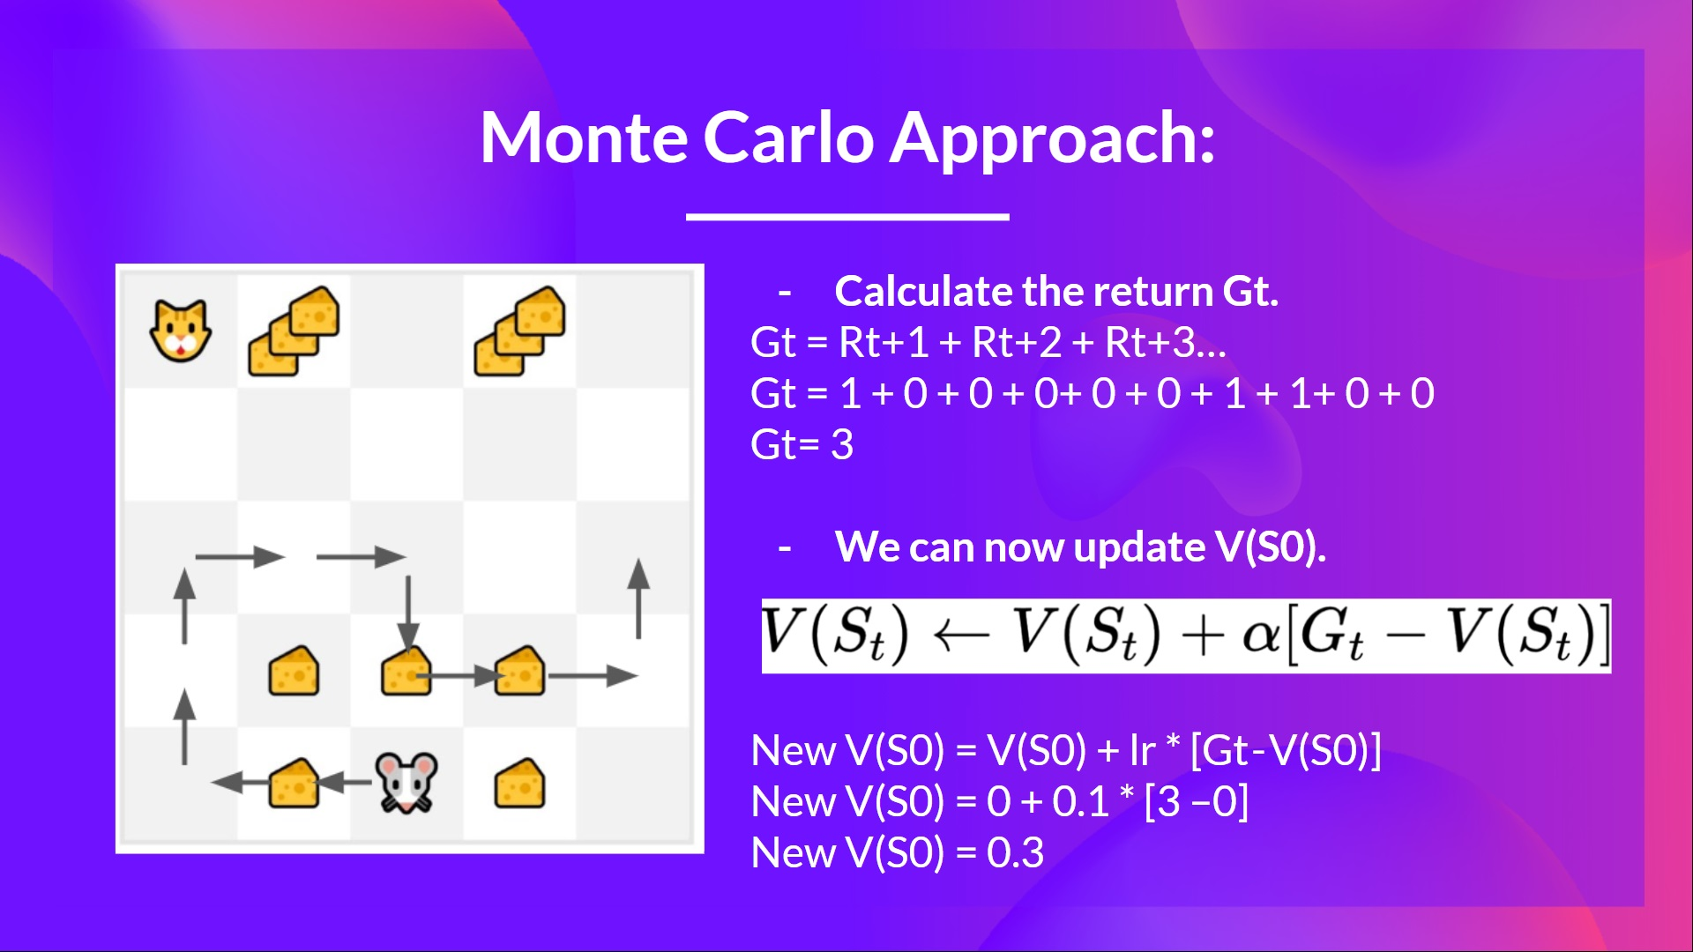

Slide 46
Outline
Introduction
Monte Carlo Learning
Temporal Difference Learning

Slide 47
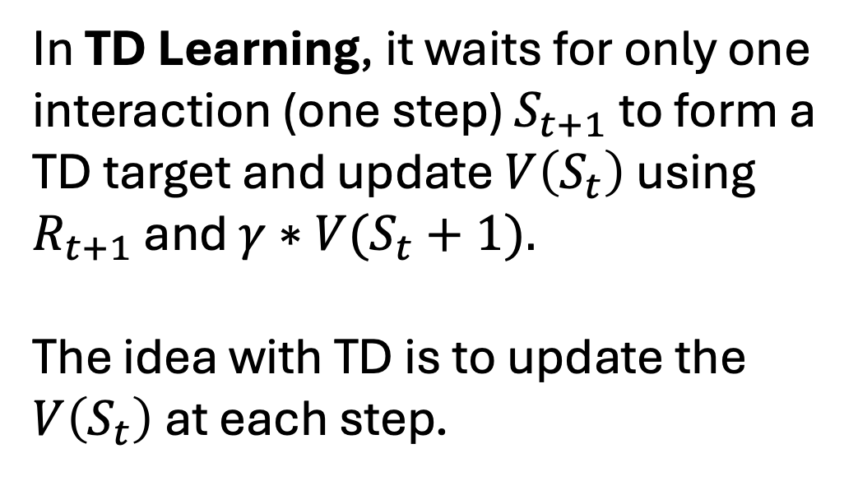
Temporal Difference Reinforcement Learning
In TD Learning, it waits for only one interaction (one step) $S_{t+1}$to form a TD target and update $V\left(S_{t}\right)$ using $R_{t+1}$ and $γ∗V(S_{t}+1).$
The idea with TD is to update the $V\left(S_{t}\right)$at each step.

Slide 48
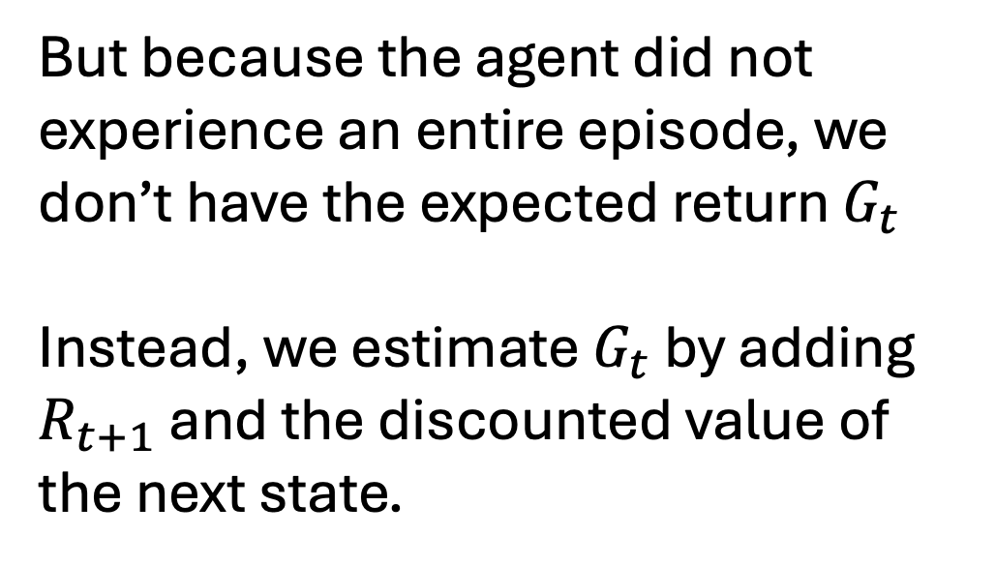
Temporal Difference Reinforcement Learning
But because the agent did not experience an entire episode, we don’t have​ the expected return $G_{t}$
Instead, we estimate $G_{t}$​ by adding $R_{t+1}$ and the discounted value of the next state.

Slide 49
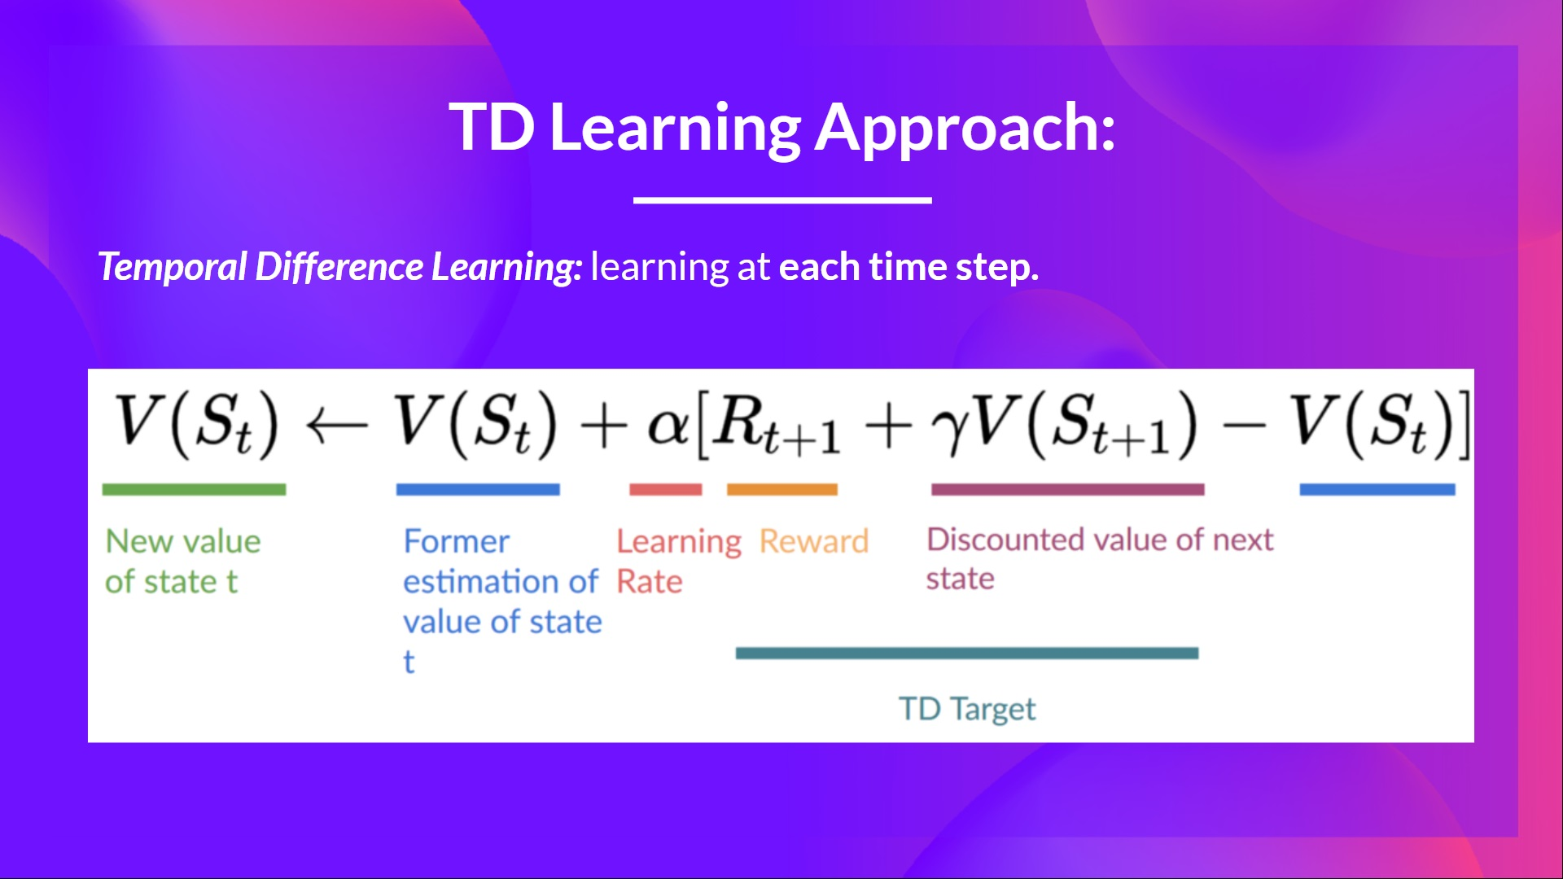

Slide 50
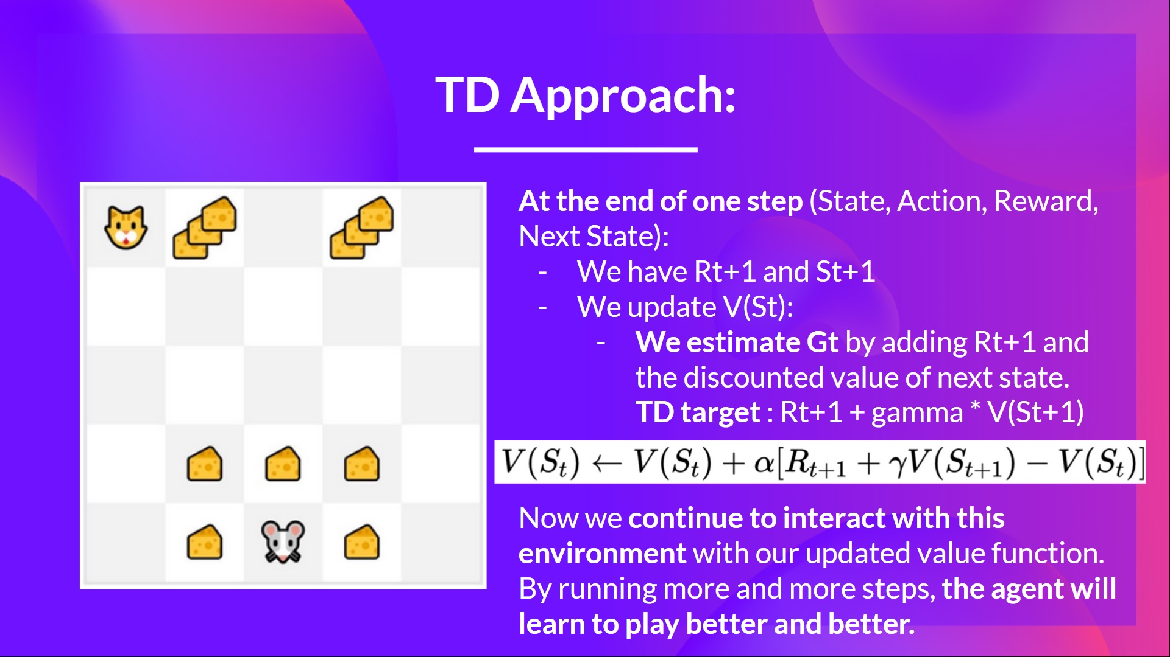

Slide 51
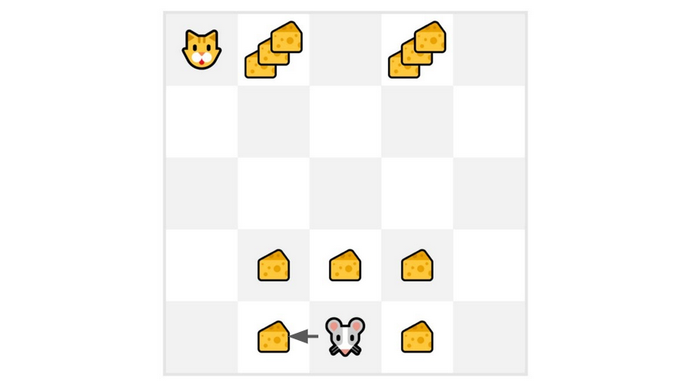

Slide 52
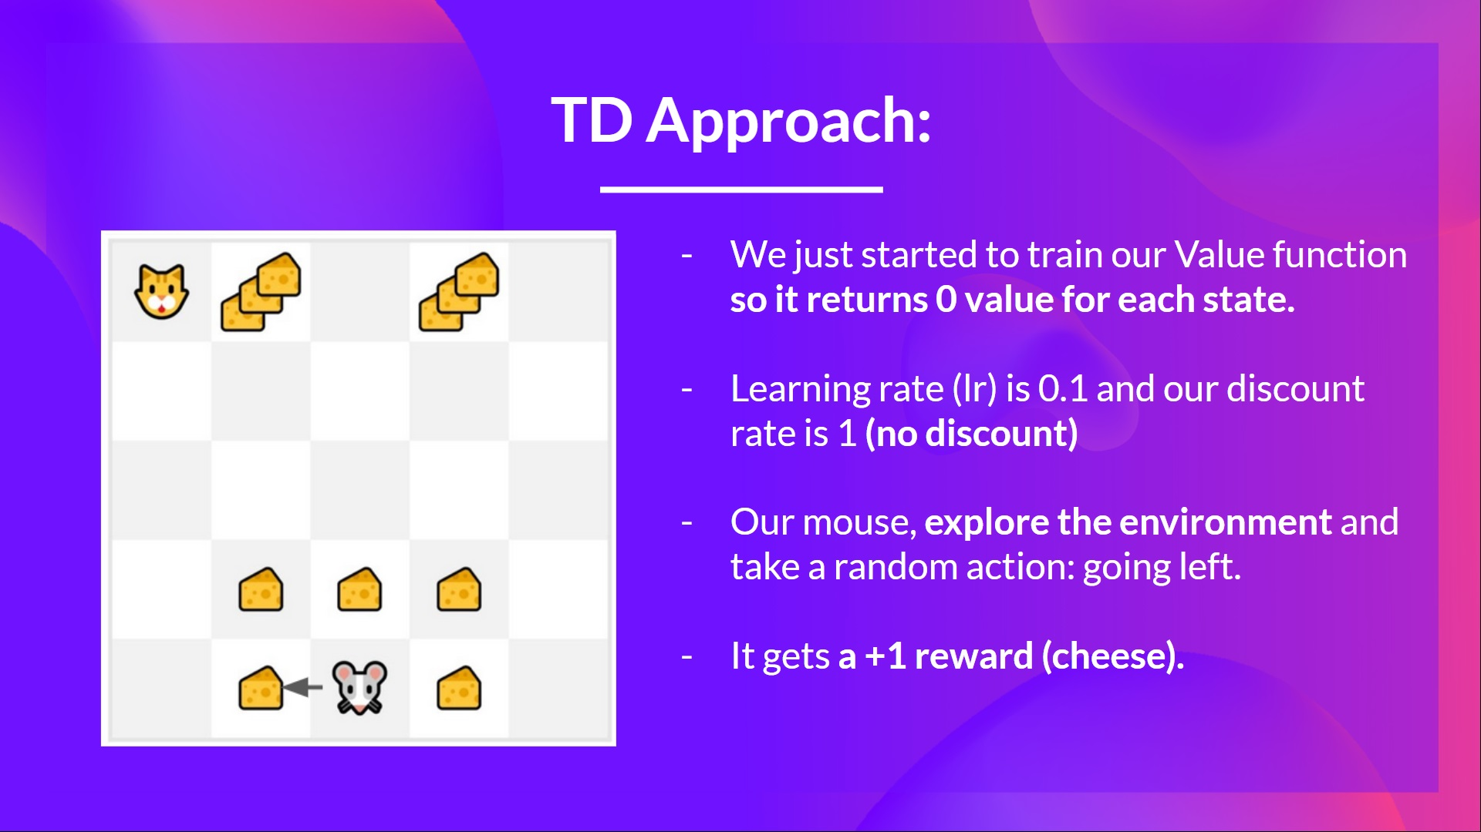

Slide 53
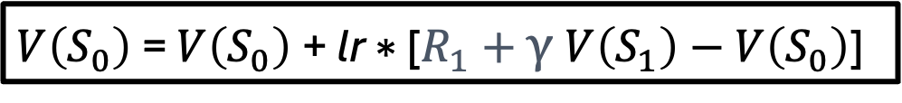


Temporal Difference Reinforcement Learning
And we compute the new value functions of all states that were visited in the episode.
$V\left(S_{0}\right)$= $V\left(S_{0}\right)$+ lr ∗ [$R_{1}+\text{γ} V\left(S_{1}\right)−V\left(S_{0}\right)\text{] }$​
$$V\left(S_{0}\right)=0+0.1 × [ 1−1 × 0 −0]$$
$$V\left(S_{0}\right)=0.1$$
Now we continue to interact with this environment with our updated value function.

Slide 54
